Slide 1

Customer Shopping Behavior Analysis
Uncovering insights from 3,900 purchases to guide strategic business decisions

Slide 2
DATASET OVERVIEW
The Foundation
3,900
18
50
Total Purchases
Data Columns
Locations
Key Data Points
Customer demographics and purchase history
Product details across 4 categories
Shopping behavior and preferences
Review ratings and subscription status

Slide 3

PHASE 1
Data Preparation in Python
01
02
Data Loading & Exploration
Cleaning & Standardization
Imported dataset, checked structure and summary statistics
Handled 37 missing values, standardized column names
03
04
Feature Engineering
Database Integration
Created age groups and purchase frequency metrics
Connected to PostgreSQL for advanced analysis

Slide 4
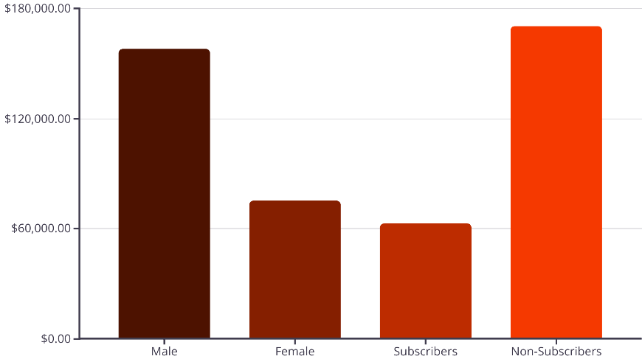
PHASE 2
SQL Analysis: Revenue Insights
Key Findings
Male customers generate 2x more revenue than female customers
Non-subscribers represent 73% of total revenue despite lower engagement
Average spend similar across subscription status: $59.49 vs $59.87

Slide 5



Discount Strategy Analysis
High-Value Discount Users
Discount-Dependent Products
Strategic Opportunity
839 customers used discounts but spent above average
Balance promotional sales with margin control for profitability
Hat (50%), Sneakers (49.7%), Coat (49.1%) lead discount usage

Slide 6

Customer Segmentation
Distribution by Loyalty
Loyal
3,116 customers
80% of base
Returning
701 customers
18% of base
New
83 customers
2% of base
958 repeat buyers (>5 purchases) have subscriptions

Slide 7
Top-Rated Products
77%
77%
76%
Gloves
Sandals
Boots
3.86 average rating
3.84 average rating
3.82 average rating
76%
76%
Hat
Skirt
3.80 average rating
3.78 average rating

Slide 8

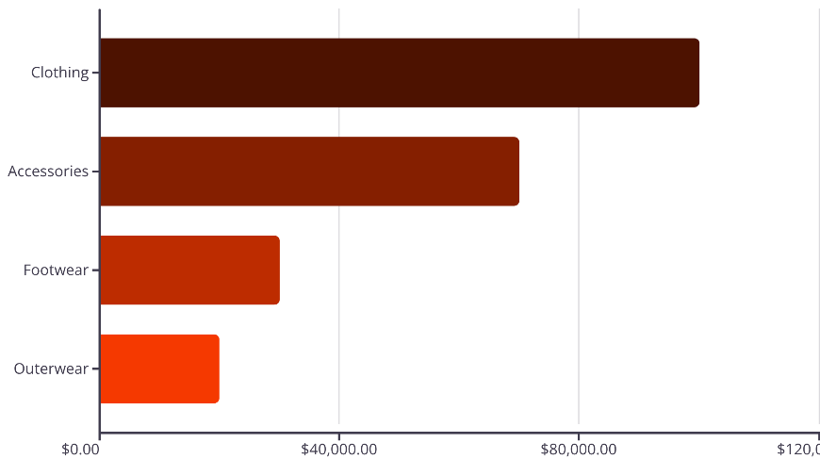
DASHBOARD INSIGHTS
Category & Age Group Performance
Revenue by Age Group
Young Adult: $62,143
Middle-aged: $59,197
Adult: $55,978
Senior: $55,763
Clothing dominates with 43% of total revenue

Slide 9

Shipping Preferences
Express Shipping
Standard Shipping
Strategic Insight
$60.48 avg purchase
$58.46 avg purchase
Express users spend 3.5% more
Higher-value customers
Cost-conscious segment
Target for premium offers

Slide 10





ACTION PLAN
Business Recommendations
Boost Subscriptions
Loyalty Programs
Optimize Discounts
Promote exclusive benefits to convert 73% non-subscribers
Reward repeat buyers to grow loyal segment beyond 80%
Balance promotional sales with margin control strategy
Targeted Marketing
Product Positioning
Focus on young adults and express-shipping users
Highlight top-rated items: Gloves, Sandals, Boots in campaigns

